Slide 1
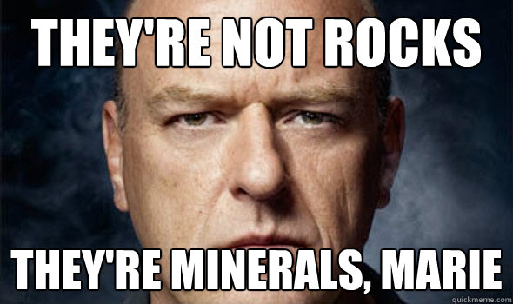

Slide 2
GENERAL QUIZ INFO
PLEASE wait outside until lab officially starts so I can set up.
20 minutes: it’s mini-lab. You will have 5 minerals to identify and will have to give me 2 properties (luster, streak, hardness, cleavage, special properties)
A couple of general “concept” questions.
Stay calm, be positive, email me with questions
PRO TIP: USE GOOGLE IMAGES AND LOOK AT DIFFERENT FORMS OF EACH MINERAL!
See you next week! Roll Tide!

Slide 3
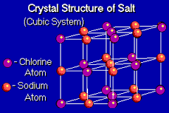
MINERAL DEFINITION
Naturally Occurring
Inorganic
Amber is not a mineral because it is made by trees
Pearls aren’t minerals because they’re made by clams
These are biologic (and therefore not inorganic) processes
Solid
Definite chemical composition
Ordered internal structure

Slide 4
MINERAL PROPERTIES
Luster: the way a mineral reflects light
Metallic or non-metallic?
If it’s non-metallic, does it look like glass (vitreous), is it pearly, is it earthy?
Color: color is important but it is not reliable for mineral identification because minerals can be different colors (quartz can be pink, purple, clear, black, and others; fluorite can also be green or purple)

Slide 5
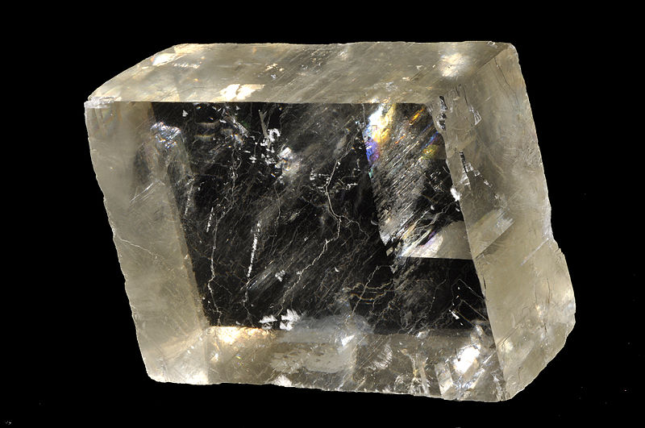
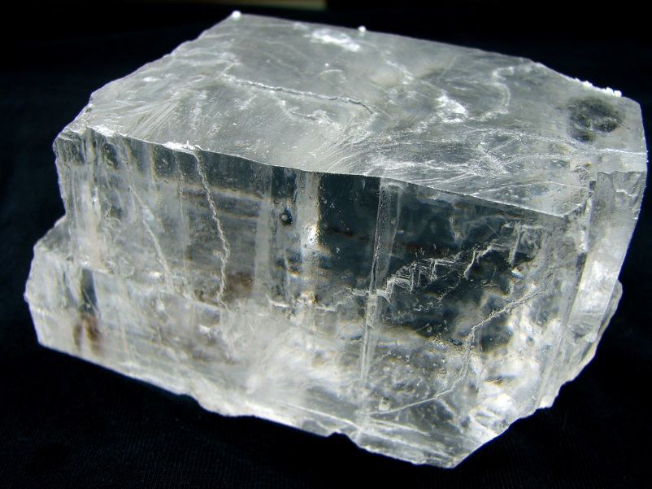
MINERAL PROPERTIES
One mineral, many colors
Two different minerals, same color

Slide 6
MINERAL PROPERTIES
Streak: the color of finely crushed material
Hardness
Resistance to scratching or breaking
Mohs Hardness Scale:
Fingernail hardness= 2.25
Copper penny= 3.5
Knife or nail (steel) and glass plate around 5.5
Harness is written as H<number, H>number, or a range: if it is harder than your fingernail but not as hard as a penny, 2.25<H<3.5

Slide 7
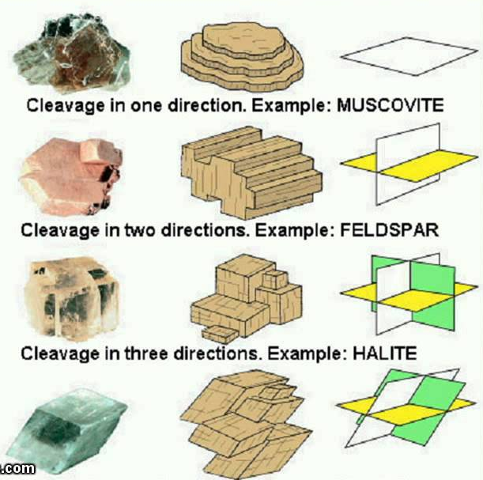
MINERAL PROPERTIES
Cleavage: the way a mineral breaks along flat planes where bonds between atoms are weaker
Give a number of cleavages, and a descriptive word: Perfect (1 for muscovite/biotite; 3 for calcite/halite/fluorite), Good
(2 for feldspar), Poor (for hornblende
and augite), Absent/NO
(quartz, magnetite)

Slide 8
SPECIAL MINERAL PROPERTIES
Magnetism: attraction to magnet
MAGNETITE is strongly magnetic.
Only the metallic minerals will be magnetic
Taste: HALITE is salt, and tastes like salt
Effervescence: CALCITE fizzes when acid is applied

Slide 9
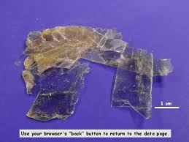
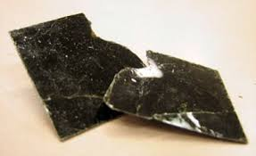
Muscovite and Biotite
Both are sub-vitreous/pearly: luster
H=2.5-3.0
Flaky, platy, made of thin layers
Muscovite translucent (clear)
Biotite is darker (black, brown, gray)
1 perfect plane of cleavage (this is why it forms layers you can peel apart)

Slide 10
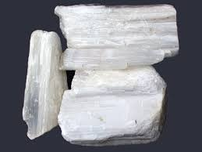
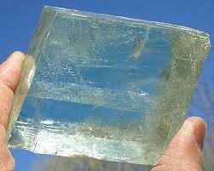
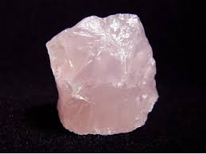
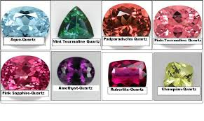
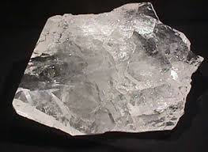
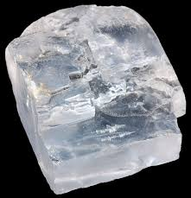
Clear/Translucent Minerals
Gypsum
H=2: fingernail
1 perfect plane of cleavage
Calcite
H=3: penny
3 perfect, parallel planes, parallelogram shaped
FIZZES
Quartz
H=7: scratches glass
No cleavage, looks glassy, CAN BE MANY COLORS (will probably be clear or pink though- no guarantees)
Halite
H=2.5
3 perfect planes (a cube)
TASTES LIKE SALT (it is salt)

Slide 11
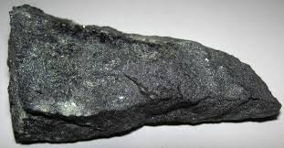
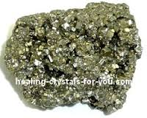
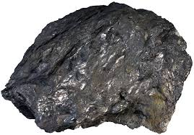
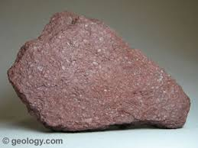
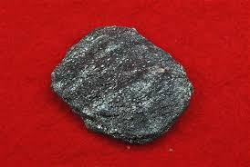
Metallic Minerals
Magnetite
May look dull, but if you move it at different angles you will see some “shimmer”
STRONGLY MAGNETIC
Pyrite
“fool’s gold”
Brass-yellow color
Forms small cubes
Gray/Greenish/Black streak
Graphite
Writes like a pencil
H=1.5-2.0
Hematite
You will probably get a red, earthy sample, but there is a metallic form.
The red form will have a brick red streak

Slide 12
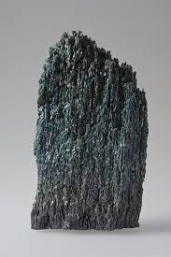
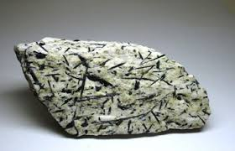
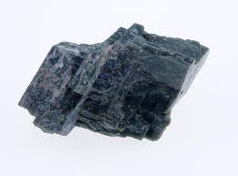
Hornblende and Augite (Both dark green/black/gray)
Amphibole
The grains look like little needles, columns, or fibers
White or no streak
2 perfect cleavages at 60 degrees and 1 at 120 degrees
Pyroxene
Kind of blocky
Greenish-gray streak
2 perfect cleavages at 90 degrees
This is a rock, but see the black “needles” that are hornblende
See what I mean by “kind of blocky?”

Slide 13
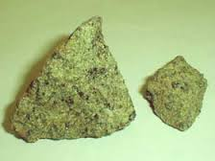
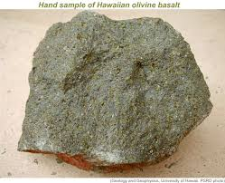
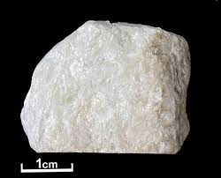
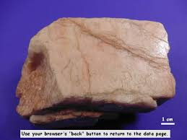
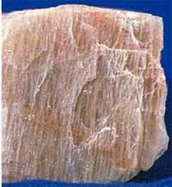
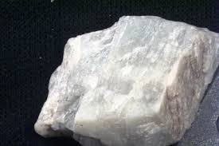
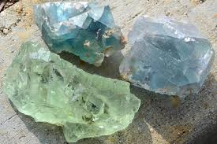
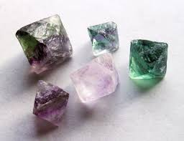
Others
Olivine
Green mineral
Opaque (cannot see through)
Earthy, not shiny
H=6.5-7, scratches glass
Talc
VERY SOFT (H=1)
GREASY OR SOAPY
A shimmery white/yellow
Feldspar
Elongated prisms (2 parallel planes)
Can be white, salmon, green, gray
Usually has some lines in parallel orientation on surface
Fluorite
Cube or diamond shape (4 perfect cleavages!)
H=4; this is how you know it’s not quartz
Usually translucent green or purple

